Slide 1
Life Expectancy
Data Analysis
Comprehensive Descriptive & Diagnostic Analytics
193 Countries • 2,938 Observations • 22 Variables

Slide 2
📊 What is Descriptive Analysis?
DESCRIPTIVE ANALYSIS - THE FOUNDATION
Descriptive analysis is the first step in data analytics that summarizes historical data to understand "What happened?"
It transforms raw data into meaningful insights through statistical measures and visualizations.
🎯 Primary Purpose: Summarize past events and identify patterns
📈 Output: Charts, graphs, summary statistics, and reports
💡 Business Value: Provides baseline understanding for decision-making
📍 Central Tendency
📊 Variability
• Mean (average)
• Median (middle value)
• Mode (most frequent)
• Measures the 'center' of data
• Standard deviation
• Range (min to max)
• Variance
• Shows data spread
📈 Visualization
🔍 Patterns
• Charts and graphs
• Dashboards
• Heat maps
• Makes data visual
• Trends over time
• Seasonal patterns
• Correlations
• Data relationships

Slide 3
🔍 What is Diagnostic Analysis?
DIAGNOSTIC ANALYSIS - GOING DEEPER
Diagnostic analysis goes beyond describing data to understand "Why did it happen?" It uses statistical methods to
identify cause-and-effect relationships and uncover the reasons behind observed patterns.
🎯 Primary Purpose: Understand causes and relationships between variables
📈 Output: Correlation coefficients, statistical tests, hypothesis validation
💡 Business Value: Enables evidence-based decision making and problem solving
🔗 Correlation Analysis
📈 Regression Analysis
• Pearson correlation
• Spearman correlation
• Measures relationships
• Strength and direction
• Linear regression
• Multiple regression
• Predicts outcomes
• Quantifies impact
🧪 Hypothesis Testing
🔍 Data Quality
• t-tests, ANOVA
• Chi-square tests
• Statistical significance
• Validates assumptions
• Missing value analysis
• Outlier detection
• Distribution analysis
• Data completeness

Slide 4
⚖️ Descriptive vs Diagnostic Analysis
KEY DIFFERENCES IN ANALYTICAL APPROACH
The two approaches complement each other to provide comprehensive data insights:
DESCRIPTIVE ANALYSIS DIAGNOSTIC ANALYSIS
• What happened? • Why did it happen?
• Summarizes historical data • Explains causes and relationships
• Basic statistical measures • Advanced statistical methods
• Reports and dashboards • Correlation matrices and tests
• Operational insights • Strategic insights
• Easy to understand • Requires statistical knowledge
1
2
3
4
Data Collection
Gather raw data from various sources
Descriptive Analysis
Summarize and visualize patterns
Diagnostic Analysis
Identify causes and relationships
Insights & Actions
Make data-driven decisions

Slide 5
📊 Our Descriptive Analysis with Power BI
POWER BI DESCRIPTIVE ANALYTICS APPROACH
We used Power BI to create interactive dashboards that answer "What happened?" in global life expectancy:
🎯 Data Summarization: Calculated averages, ranges, and distributions across 193 countries
📊 Visual Patterns: Created geographic maps, time-series charts, and comparison views
📈 Trend Identification: Analyzed 16-year trends (2000-2015) for pattern recognition
🌍 Country Comparisons: Ranked countries and identified top/bottom performers
🌍 Global Metrics
📊 Development Status
• Average: 69.22 years
• Range: 52.7 years (36.3-89.0)
• 193 countries analyzed
• Developed: 79.20 years avg
• Developing: 67.11 years avg
• Gap: 12.09 years
📈 Time Trends
• Consistent improvement
• Both groups progressing
• Developing countries faster

Slide 6
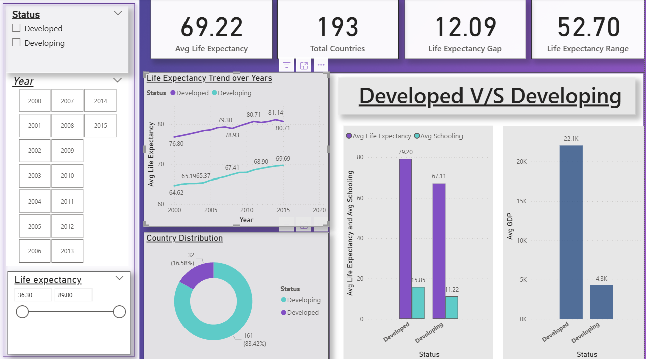
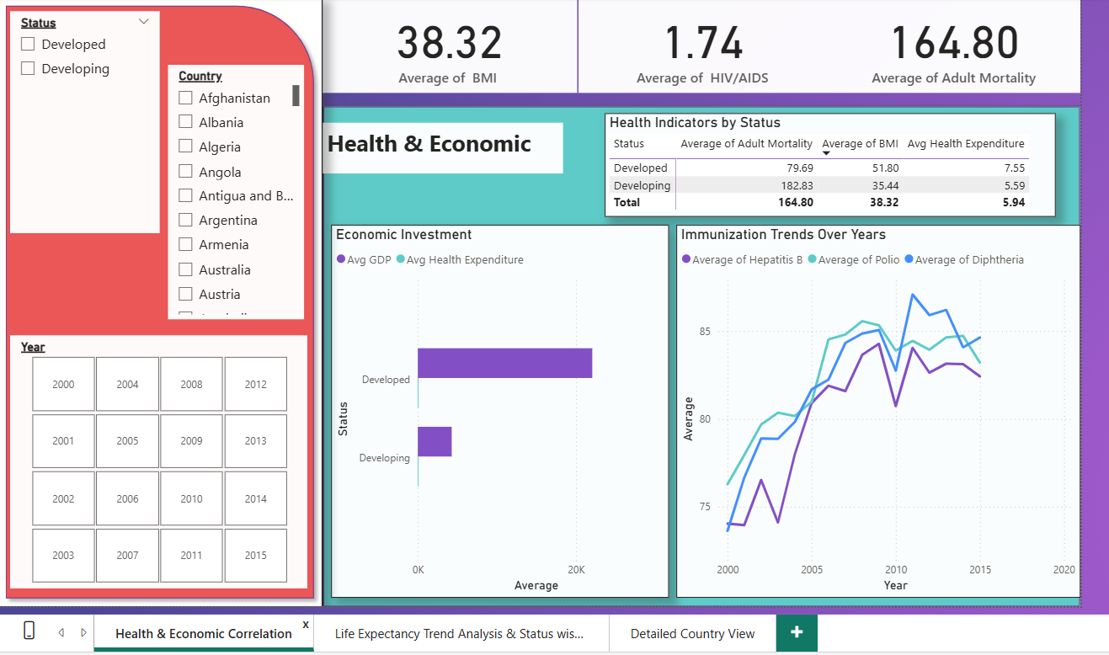
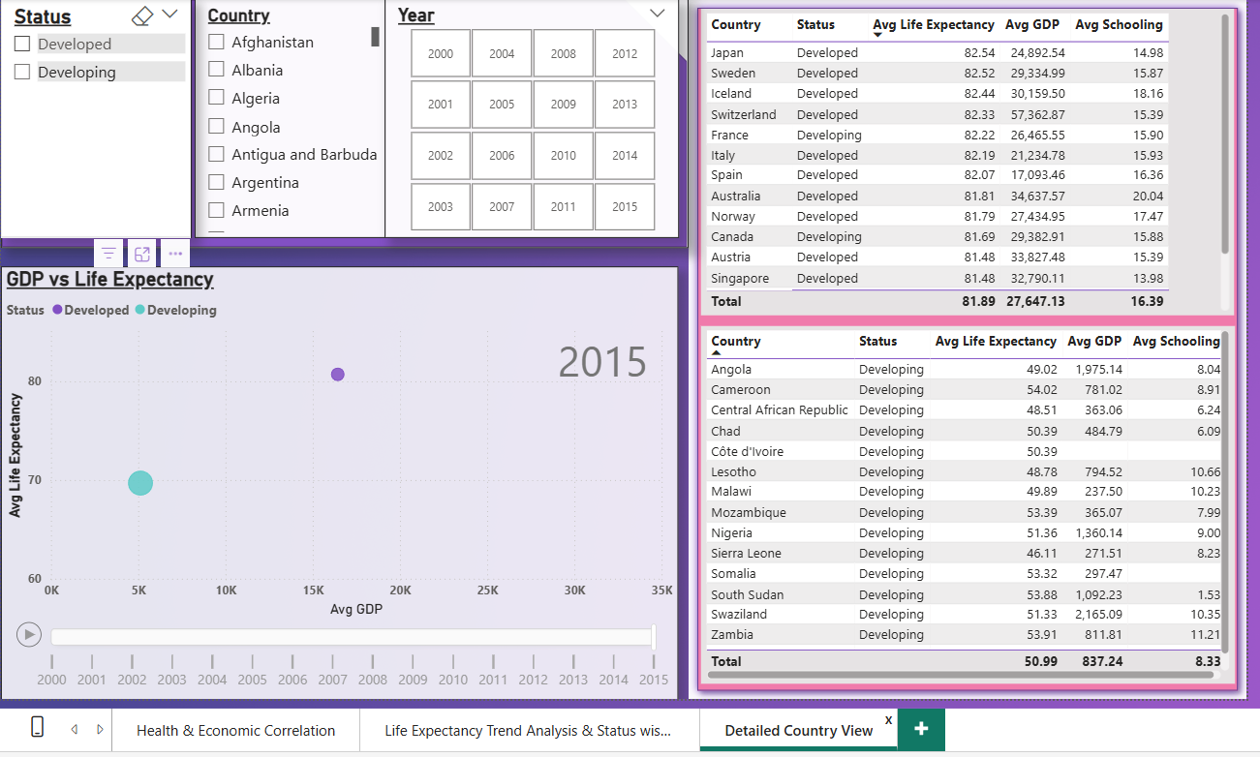
🌍 Global Metrics
• Average: 69.22 years
• Range: 52.7 years (36.3-89.0)
• 193 countries analyzed
📈 Time Trends
• Consistent improvement
• Both groups progressing
• Developing countries faster
📊 Development Status
• Developed: 79.20 years avg
• Developing: 67.11 years avg
• Gap: 12.09 years

Slide 7
📋 Power BI Dashboard Features & Insights
INTERACTIVE DASHBOARD COMPONENTS
Our Power BI dashboards included multiple interactive elements for comprehensive data exploration:
🔍 Interactive Filters: Country selection, year sliders, development status toggles
📊 Statistical Cards: Key metrics with conditional formatting and trend indicators
📈 Time-Series Charts: Multi-year trends with drill-down capabilities
🏆 Performance Rankings: Top/bottom country lists with dynamic updates
🏆 Success Stories
⚠️ Critical Areas
🏥 Health Indicators
• Chile: 85.0 years (developing)
• Costa Rica: 79.6 years
• Cuba: 79.1 years
• Sierra Leone: 51.0 years
• Central African Rep: 52.5
• Chad: 53.1 years
• BMI average: 38.32
• HIV/AIDS: 1.74 average
• Adult mortality: 164.80

Slide 8
🔍 Our Diagnostic Analysis with Python
PYTHON DIAGNOSTIC ANALYTICS APPROACH
We used Python and Jupyter Notebooks to answer "Why do some countries have higher life expectancy?":
🔬 Statistical Analysis: Calculated correlation coefficients between life expectancy and all variables
📊 Distribution Analysis: Examined data patterns, skewness, and normality
🔍 Data Quality Assessment: Analyzed missing values, outliers, and data completeness
📈 Relationship Mapping: Created scatter plots to visualize variable relationships
🔗 Correlation Matrix
🔍 Missing Value Analysis
• Calculated all pairwise correlations
• Identified strongest relationships
• Statistical significance testing
• Population: 22.2% missing
• GDP: 15.3% missing
• Life expectancy: 0.34% missing
📊 Distribution Analysis
📈 Scatter Plot Analysis
• Mean: 69.22 years
• Std dev: 9.52 years
• Slight left skew identified
• Visual relationship patterns
• Linear/non-linear relationships
• Outlier identification

Slide 9
🎯 Python Correlation Analysis Results
KEY CORRELATION FINDINGS WITH LIFE EXPECTANCY
Our statistical analysis revealed the most important factors influencing life expectancy globally:
Strong positive correlations indicate factors that increase life expectancy, while negative correlations show factors that decrease it.
🎓 Education (Schooling)
r=0.715
Strongest positive predictor - Education enables better health choices
💰 Income Composition
r=0.692
Human development index - Knowledge-based economies perform better
🍎 BMI (Nutrition)
r=0.559
Adequate nutrition essential - Undernourished populations suffer
⚰️ Adult Mortality
r=-0.696
Strong negative impact - High adult death rates reduce overall longevity
🦠 HIV/AIDS
r=-0.557
Disease burden effect - Epidemic diseases significantly impact populations

Slide 10
🚀 Evidence-Based Recommendations
DATA-DRIVEN POLICY RECOMMENDATIONS
Based on our comprehensive descriptive and diagnostic analysis, we recommend focusing on these high-impact areas:
1
2
3
Education Investment
Healthcare Systems
Nutrition Security
• Universal primary &
secondary education
• Adult literacy programs
• Health education initiatives
• Female education prioritization
• Immunization program expansion
• Adult mortality reduction
• Primary healthcare access
• Disease prevention focus
• Child malnutrition prevention
• Food security policies
• Maternal health programs
• Nutrition education

Slide 11
💡 Key Takeaways & Next Steps
COMPREHENSIVE ANALYSIS CONCLUSIONS
Our dual-method analysis combining descriptive and diagnostic approaches revealed:
📊 DESCRIPTIVE INSIGHTS: Clear global patterns with 12+ year gap between developed/developing countries
🔍 DIAGNOSTIC INSIGHTS: Education emerges as strongest predictor (r=0.752) of life expectancy
🎯 POLICY IMPLICATIONS: Strategic investment in education, healthcare, and nutrition can improve outcomes
📈 SUCCESS STORIES: Countries like Chile prove high performance possible regardless of development status
🏃 Immediate Actions
🔬 Research Extensions
⚡ Implementation
• Expand data collection post-2015
• Include environmental factors
• Add sub-national analysis
• Causal inference studies
• Machine learning models
• Longitudinal analysis
• Country-specific recommendations
• Policy effectiveness tracking
• Stakeholder engagement

